Slide 1
Diseases of
Tracheobronchial Tree
Dr S Jaya Sandeep

Slide 2
Acute Tracheitis
Acute tracheitis is an inflammation of the lining membrane of trachea, which may follow laryngitis and bronchitis.
It may be caused by bacteria or viruses.
The patient presents with cough and retrosternal pain or discomfort along with difficulty in respiration and croupy noise. Mild constitutional symptoms may be present such as body aches and fever.
It is treated by antibiotics and anti-inflammatory drugs along with antitussive agents and steam inhalation.

Slide 3
Laryngotracheobronchitis
Acute laryngotracheobronchitis is a dangerous infection seen mostly in children, which involves tracheobronchial tree.
Causative agents
Viruses such as myxovirus, parainfluenza virus type I and II
Streptococcus, Staphylococcus and H. Influenzae

Slide 4
Clinical Features
• Sudden onset of fever
• Painful croupy cough with hoarseness
• Respiratory distress with inspiratory stridor
• Toxemia, cyanosis and circulatory failure
• Examination shows crepts and ronchi due to sticky secretions
• IDL shows congestion and edema of laryngotracheal region with dry crusts on larynx
Steeple sign on X-ray showing a narrow subglottis is typical of this disease.

Slide 5
Treatment
• Admission to hospital is mandatory
• Intravenous antibiotics
• Anti-inflammatory drugs
• Oxygen inhalation
• Intravenous hydrocortisone injection
• Steam inhalation
• Toilet of tracheobronchial tree
• Tracheostomy for respiratory distress if required.

Slide 6
Lung Collapse
Lung collapse occurs when there is bronchial obstruction due to various causes with inability of air to reach segment of lung which collapses.
Obstruction may be due to foreign body, new growth, plug of mucus or blood clot after trauma.
The patient has acute pain and difficulty in breathing with mediastinal shift to same side. On auscultation, there is absence of breath sounds over the collapsed area.
X-ray chest confirms the findings of collapse.

Slide 7
Treatment
• Complete bed rest
• Causative factor should be removed immediately
• Bronchoscopic suction
• Antibiotics to control infection
• Deep breathing exercises with physiotherapy helps in better drainage and aeration of collapsed lung.

Slide 8
Lung Abscess
Lung abscess may result after aspiration of mucus or blood, as seen postoperatively or due to an impacted foreign body in the bronchi.
Clinical Features
The patient has constitutional features such as fever, malaise,
looks unwell and has dyspnea.
Examination shows restricted or no air entry and radiology
confirms the diagnosis

Slide 9
Treatment
• Systemic antibiotics
• Bronchial suction
• Encourage postural drainage
• Lobectomy may have to be done.

Slide 10
Growths of Tracheobronchial Tree
Growths of tracheobronchial tree may be benign such as chondroma, papillomas, angiomas or fibromas.
Malignant growths may be primary or secondary. These are usually squamous cell carcinoma, oat cell carcinoma or adenocarcinoma.
Causes
• Smoking is an important factor
• Gases from burning of diesel, tar, petrol or other chemicals
• Contact with radioactive substances

Slide 11
Symptomatology
• Slow onset, males 40 to 60 years are affected more
• Persistent cough, dry or may be blood stained
• Loss of weight with discomfort in the chest
• Hemoptysis
• Voice changes
• Wheezing and dyspnea
• On examination, signs of consolidation may be seen
• Vocal cord paralysis may be seen on indirect laryngoscopy (IDL) exam.

Slide 12
X-ray must be done to see consolidation, pulmonary opacity, pleural effusion or emphysema. Computed tomography (CT) scan is also useful.
Diagnosis is confirmed by bronchoscopic biopsy or cytology of secretions.
Treatment
Lobectomy or pneumonectomy is the best method of
treatment as radiotherapy only acts as a palliative measure.

Slide 13
Tracheoesophageal Fistula
Congenital Tracheoesophageal Fistula
It is associated with atresia of esophagus child presents with regurgitation of all feeds with attacks of coughing, choking and cyanosis on taking feed
Diagnosis is confirmed by inability of nasogastric tube to pass down and by using contrast, which confirms to fistula
Treatment is surgical repair by transthoracic approach

Slide 14
Acquired Tracheoesophageal Fistula
It may occur as a result of malignancy, iatrogenic following rigid endoscopy or trauma due to foreign body or penetrating wound
Coughing and choking after taking food is the main symptom
Treatment is by conservative management such as intravenous (IV) fluids, nil orally, Ryle’s tube and antibiotics
Surgical repair is done if indicated

Slide 15
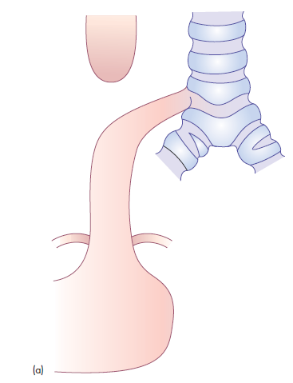
(a) Oesophageal atresia with distal trachaeooesophageal fistula, 87 percent

Slide 16
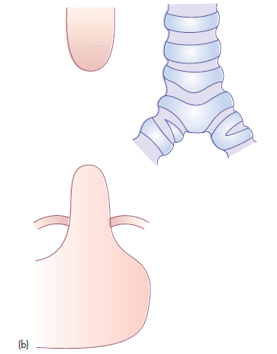
(b) oesophageal atresia without distal trachaeooesophageal fistula, 6–7 percent

Slide 17
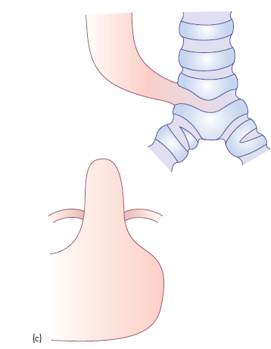
(c) oesophageal atresia with proximal trachaeooesophageal
fistula, 2 percent

Slide 18
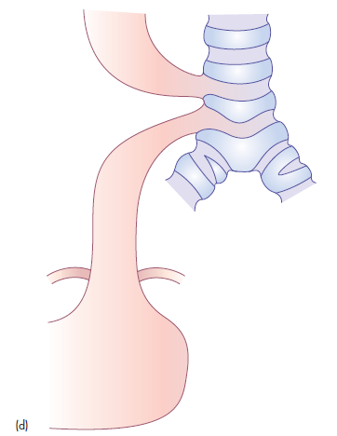
(d) oesophageal atresia with proximal and distal trachaeooesophageal fistula, <1 percent

Slide 19
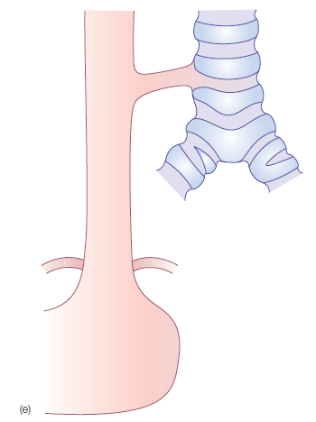
(e) trachaeooesophageal fistula without oesophageal atresia, 3–4 percent

Slide 20
Thank you

